Slide 1
Outline
Characterization of agents and environments
Rationality
PEAS (Performance measure, Environment, Actuators, Sensors)
Environment types
Agent types
Intelligent agent-view provides framework to integrate the
many subareas of AI.

Slide 2
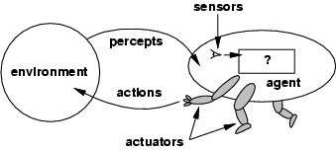
Agents
Definition: An agent perceives its environment via sensors and acts upon that environment through its actuators

Slide 3

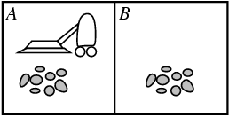
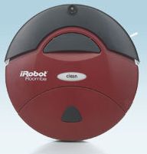
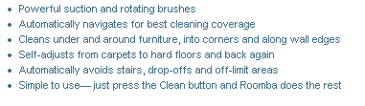
E.g., vacuum-cleaner world
Agent / Robot
Percepts: location and contents, e.g., [A, Dirty]
Actions: Left, Right, Suck, NoOp
iRobot Corporation
Founder Rodney Brooks (MIT)

Slide 4
Rational agents
An agent should strive to "do the right thing", based on what:
it can perceive and
the actions it can perform.
The right action is the one that will cause the agent to be most successful
Performance measure: An objective criterion for success of an agent's behavior.
Performance measures of a vacuum-cleaner agent: amount of dirt cleaned up, amount of time taken, amount of electricity consumed, level of noise generated, etc.
Performance measures self-driving car: time to reach destination (minimize), safety, predictability of behavior for other agents, reliability, etc.
Performance measure of game-playing agent: win/loss percentage (maximize), robustness, unpredictability (to “confuse” opponent), etc.

Slide 5
Definition of Rational Agent:
For each possible percept sequence, a rational agent should select
an action that maximizes its performance measure (in expectation)
given the evidence provided by the percept sequence and whatever built-
in knowledge the agent has.
Why “in expectation”?
Captures actions with stochastic / uncertain effects or
actions performed in stochastic environments.
We can then look at the expected value of an action.
In high-risk settings, we may also want to limit the
worst-case behavior.

Slide 6
Rational agents
Notes:
Rationality is distinct from omniscience (“all knowing”). We can
behave rationally even when faced with incomplete information.
Agents can perform actions in order to modify future percepts so as to obtain useful information: information gathering, exploration.
An agent is autonomous if its behavior is determined by its own experience (with ability to learn and adapt).

Slide 7
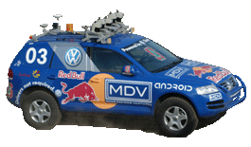
Characterizing a Task Environment
Must first specify the setting for intelligent agent design.
PEAS: Performance measure, Environment, Actuators, Sensors
Example: the task of designing a self-driving car
Performance measure Safe, fast, legal, comfortable trip
Environment Roads, other traffic, pedestrians
Actuators Steering wheel, accelerator, brake, signal, horn
Sensors Cameras, LIDAR (light/radar), speedometer, GPS, odometer
engine sensors, keyboard

Slide 8
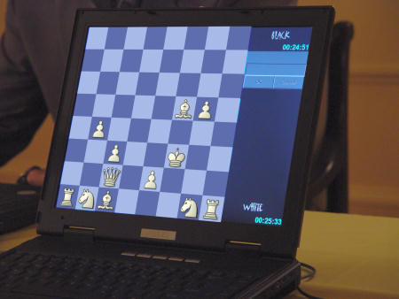
Task Environments
1) Fully observable / Partially observable
If an agent’s sensors give it access to the
complete state of the environment needed
to choose an action, the environment is
fully observable.
(e.g. chess – what about Kriegspiel?)
Notes:
Kriegspiel chess variant in which each player can see their own pieces, but not those of their opponent. )

Slide 9
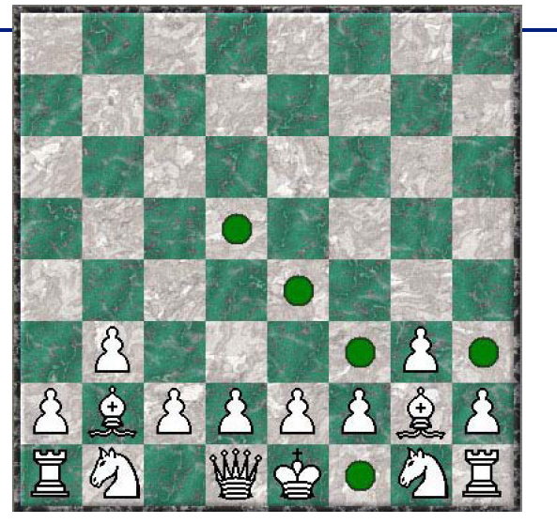
Incomplete /
uncertain information
inherent in
the game.
Balance
exploitation (best move given current knowledge)
and exploration (moves to explore where opponent’s pieces might be).
Use probabilistic
reasoning techniques.
Making things a bit more challenging…
Kriegspiel --- you can’t see your opponent!

Slide 10
2) Deterministic / Stochastic
An environment is deterministic if the next state of the environment is completely determined by the current state of the environment and the action of the agent;
In a stochastic environment, there are multiple, unpredictable outcomes. (If the environment is deterministic except for the actions of other agents, then the environment is strategic).
In a fully observable, deterministic environment, the agent need not deal with uncertainty.
Note: Uncertainty can also arise because of computational limitations. E.g., we may be playing an omniscient (“all knowing”) opponent but we may not be able to compute his/her moves.
Notes:
Kriegspiel chess variant in which each player can see their own pieces, but not those of their opponent. )

Slide 11
3) Episodic / Sequential
In an episodic environment, the agent’s experience is divided into atomic
episodes. Each episode consists of the agent perceiving and then performing
a single action.
Subsequent episodes do not depend on what actions occurred in previous
episodes. Choice of action in each episode depends only on the episode itself.
(E.g., classifying images.)
In a sequential environment, the agent engages in a series of connected
episodes. Current decision can affect future decisions. (E.g., chess and driving)
4) Static / Dynamic
A static environment does not change while the agent is thinking.
The passage of time as an agent deliberates is irrelevant.
The environment is semidynamic if the environment itself does not change
with the passage of time but the agent's performance score does.

Slide 12
5) Discrete / Continuous
If the number of distinct percepts and actions is limited, the environment is discrete, otherwise it is continuous.
6) Single agent / Multi-agent
If the environment contains other intelligent agents, the agent needs to be concerned about strategic, game-theoretic aspects of the environment (for either cooperative or competitive agents).
Most engineering environments don’t have multi-agent properties, whereas most social and economic systems get their complexity from the interactions of (more or less) rational agents.

Slide 13
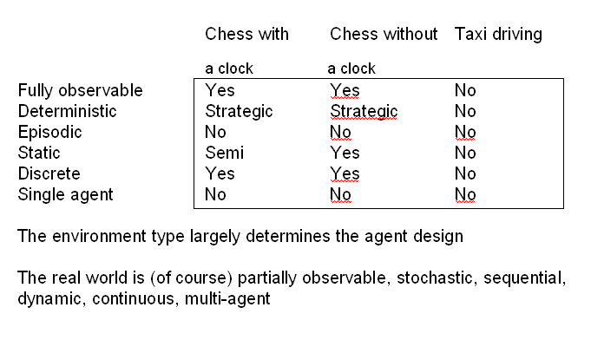
Example Tasks and Environment Types
How to make the right decisions?
Decision theory

Slide 14
Agents and environments
The agent function maps from percept histories to actions
f: P* → A
The agent program runs (internally) on the physical architecture to produce f
agent = architecture + program
our focus
Design an agent program assuming an archictecture that will make the percepts from
the sensors available to the program.

Slide 15
Types of Agents

Slide 16
I) --- Table-lookup driven agents
Uses a percept sequence / action table in memory to
find the next action. Implemented as a (large) lookup table.
Drawbacks:
Huge table (often simply too large)
Takes a long time to build/learn the table

Slide 17
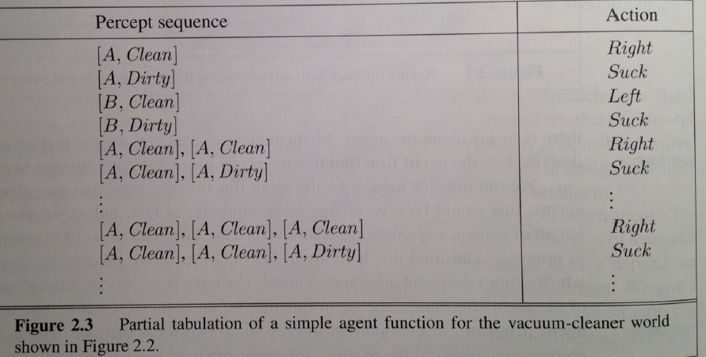
Toy example:
Vacuum world.
Percepts: robot senses it’s location and “cleanliness.”
So, location and contents, e.g., [A, Dirty], [B, Clean].
With 2 locations, we get 4 different possible sensor inputs. Actions: Left, Right, Suck, NoOp

Slide 18
Table lookup
Action sequence of length K, gives 4^K different possible sequences.
At least many entries are needed in the table. So, even in this very toy
world, with K = 20, you need a table with over 4^20 > 10^12 entries.
In more real-world scenarios, one would have many more different
percepts (eg many more locations), e.g., >=100. There will therefore be
100^K different possible sequences of length K. For K = 20, this would
require a table with over 100^20 = 10^40 entries. Infeasible to even store.
So, table lookup formulation is mainly of theoretical interest. For practical
agent systems, we need to find much more compact representations. For
example, logic-based representations, Bayesian net representations,
or neural net style representations, or use a different agent architecture,
e.g., “ignore the past” --- Reflex agents.

Slide 19
II) --- Simple reflex agents
Agents do not have memory of past world states or percepts.
So, actions depend solely on current percept.
Action becomes a “reflex.”
Uses condition-action rules.

Slide 20
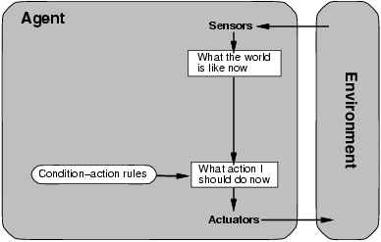
Agent selects actions on the basis
of current percept only.
If tail-light of car in front is red, then brake.

Slide 21
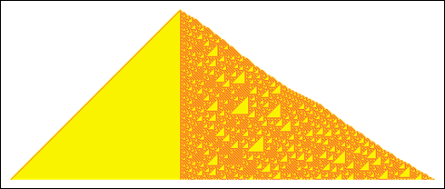

Simple reflex agents
Closely related to “behaviorism” (psychology; quite
effective in explaining lower-level animal behaviors, such
as the behavior of ants and mice).
The Roomba robot largely behaves like this. Behaviors are robust and
can be quite effective and surprisingly complex.
But, how does complex behavior arise from simple reflex behavior?
E.g. ants colonies and bee hives are quite complex.
Simple rules in a diverse environment can
give rise to surprising complexity.
See A-life work (artificial life) community,
and Wolfram’s cellular automata.

Slide 22
III) --- Model-based reflex agents
Key difference (wrt simple reflex agents):
Agents have internal state, which is used to keep track of past states of the world.
Agents have the ability to represent change in the World.
Example: Rodney Brooks’ Subsumption Architecture
--- behavior based robots.

Slide 23
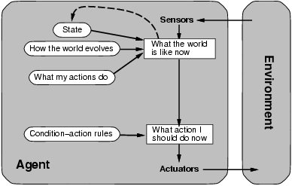
Model-based reflex agents
Module:
Logical Agents
Representation and Reasoning: Part III/IV R&N
[Here]
How detailed?
“Infers potentially
dangerous driver
in front.”
If “dangerous driver in front,”
then “keep distance.”
Notes:
Handling partial observability:
Agent maintains some sort of internal state that depends on the percept history.
Updating internal state requires:
→information on how the world evolves
→information on how the agent’s actions affect the world
→ model-based agent

Slide 24
An example: Brooks’ Subsumption Architecture
Main idea: build complex, intelligent robots by decomposing behaviors into a hierarchy of skills, each defining a percept-action cycle for one very specific task.
Examples: collision avoidance, wandering, exploring, recognizing doorways, etc.
Each behavior is modeled by a finite-state machine with a few states (though each state may correspond to a complex function or module;
provides internal state to the agent).
Behaviors are loosely coupled via asynchronous interactions.
Note: minimal internal state representation.
p. 1003 R&N

Slide 25
Subsumption Architecture, cont.
In subsumption architecture, increasingly complex behaviors arise from the combination of simple behaviors.
The most basic simple behaviors are on the level of reflexes: • avoid an object; • go toward food if hungry, • move randomly.
A more complex behavior that sits on top of simple behaviors may be “go across the room.”
The more complex behaviors subsume the less
complex ones to accomplish their goal.

Slide 26
How much of an internal model of the world?
Planning in and reasoning about our surroundings appears to require
some kind of internal representation of our world. We can “try” things
out in this representation. Much like an running a “simulation” of the
effect of actions or a sequence of actions in our head.
General assumption for many years:
The more detailed internal model, the better.
Brooks (mid 80s and 90s) challenged this view:
The philosophy behind Subsumption Architecture is that the world should be used as its own model. According to Brooks, storing models of the world is dangerous in dynamic, unpredictable environments because representations might be incorrect or outdated. What is needed is the ability to react quickly to the present. So, use minimal internal state representation, complement at each time step with sensor input.
Debate continues to this day: How much of our world do we (should we)
represent explicitly? Subsumption architecture worked well in robotics.

Slide 27
IV) --- Goal-based agents
Key difference wrt Model-Based Agents:
In addition to state information, have goal information that
describes desirable situations to be achieved.
Agents of this kind take future events into consideration.
What sequence of actions can I take to achieve certain goals?
Choose actions so as to (eventually) achieve a (given or computed) goal.
→ problem solving and search! (R&N --- Part II, chapters 3 to 6)

Slide 28
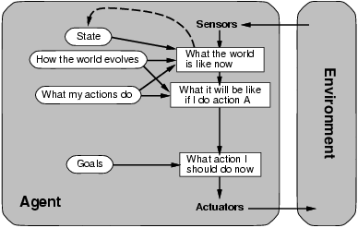
Goal-based agents
Module:
Problem Solving
Considers “future”
“Clean kitchen”
Agent keeps track of the world state as well as set of goals it’s trying to achieve: chooses
actions that will (eventually) lead to the goal(s).
More flexible than reflex agents → may involve search and planning

Slide 29
V) --- Utility-based agents
When there are multiple possible alternatives, how to decide which one is best?
Goals are qualitative: A goal specifies a crude distinction between a happy and unhappy state, but often need a more general performance measure that describes “degree of happiness.”
Utility function U: State → R indicating a measure of success or happiness when at a given state.
Important for making tradeoffs: Allows decisions comparing choice between conflicting goals, and choice between likelihood of success and importance of goal (if achievement is uncertain).
Use decision theoretic models: e.g., faster vs. safer.

Slide 30
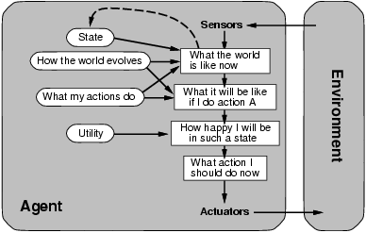
Utility-based agents
Module:
Decision Making
Decision theoretic actions:
e.g. faster vs. safer

Slide 31
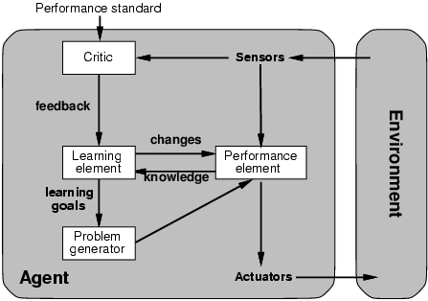
VI) --- Learning agents Adapt and improve over time
More complicated when agent needs to learn utility information: Reinforcement learning
(based on action payoff)
Module:
Learning
“Quick turn is not safe”
No quick turn
Road conditions, etc
Takes percepts
and selects actions
Try out the brakes on
different road surfaces

Slide 32
Summary: agent types
(1) Table-driven agents
use a percept sequence/action table in memory to find the next action. They are implemented by a (large) lookup table.
(2) Simple reflex agents
are based on condition-action rules, implemented with an appropriate production system. They are stateless devices which do not have memory of past world states.
(3) Agents with memory - Model-based reflex agents
have internal state, which is used to keep track of past states of the world.
(4) Agents with goals – Goal-based agents
are agents that, in addition to state information, have goal information that describes desirable situations. Agents of this kind take future events into consideration.
(5) Utility-based agents
base their decisions on classic axiomatic utility theory in order to act rationally.
(6) Learning agents
they have the ability to improve performance through learning.

Slide 33
Summary
An agent perceives and acts in an environment, has an architecture, and is implemented by an agent program.
A rational agent always chooses the action which maximizes its expected performance, given its percept sequence so far.
An autonomous agent uses its own experience rather than built-in knowledge of the environment by the designer.
An agent program maps from percept to action and updates its internal state.
Reflex agents (simple / model-based) respond immediately to percepts.
Goal-based agents act in order to achieve their goal(s), possible sequence of steps.
Utility-based agents maximize their own utility function.
Learning agents improve their performance through learning.
Representing knowledge is important for successful agent design.
The most challenging environments are partially observable, stochastic, sequential, dynamic, and continuous, and contain multiple intelligent agents.

